Slide 1
INFO5100 Final Project
Team Name: TeamName
Memebers: Lin, LiangYen/ 001304148
Tsai, YuTing / 001304955
Kuo, DahWei/ 001372878

Slide 2
Outline
Problem
Solution
Intro to Our Application :
Basic Concepts
Architecture
Enterprises and Organizations
Screenshots & work flows/ work requests
Global level
Demo

Slide 3
Problem
Due to resource inequality, medical resources are grouped in bigger cities, people live in remote area need to search for a better medical treatment in a bigger city.
It is already a great burden for people to afford the medical fee in a big city, with the hotel fee, it’s even worse. And this is the problem we try to solve!
Notes:
Even worse

Slide 4
Solution
Ronald McDonald’s House Charities (RMHC) has solved some of the housing problems when people search for medical treatment. However, the power of a company is limited. We believed that with the help of many individual power, this will be a lot more helpful for people in need.
So we combine the idea of Airbnb and RMHC. Our system allows people to provide their personal housing for those who cannot afford the hotel.
With proper management, we can help a patient/ patient’s family, by providing them a suitable room with no cost.
Notes:
Speech: inspired by RMHC

Slide 5
Intro to Our Application
Basic concept of the system:
Allows people or company to offer their rooms for people who need it.
Allows people who need it to apply for a room.
Coordinate enterprise can approved the rooms offered by companies/ person,
and the applications from clients(patients).
Coordinate enterprise can match the rooms for the clients.

Slide 6
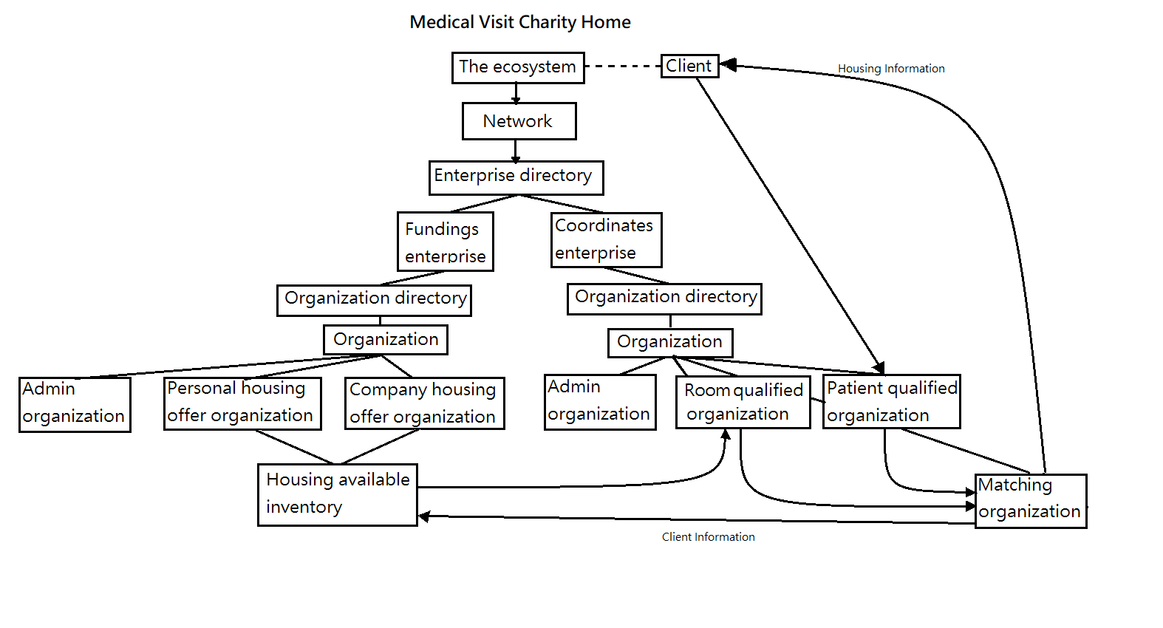
Intro to Our Application
Architecture:
Notes:
Coor enterprise can see client, 把client 拉近coordinate的enterprise 底下，so the matching/ patient, can do their work

Slide 7
Intro to Our Application
Enterprises:
Funding enterprises
Coordinate enterprises
Organizations:
Patients/ Rooms qualified organization
Client organization
Matching organization
Personal housing offers organization
Company housing offers organization
Admin organization

Slide 8
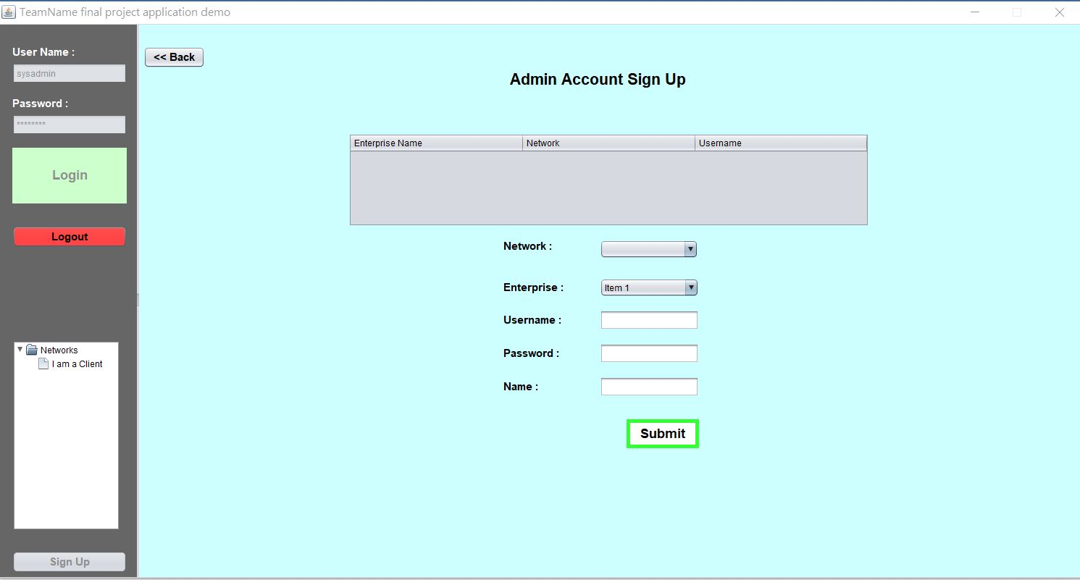
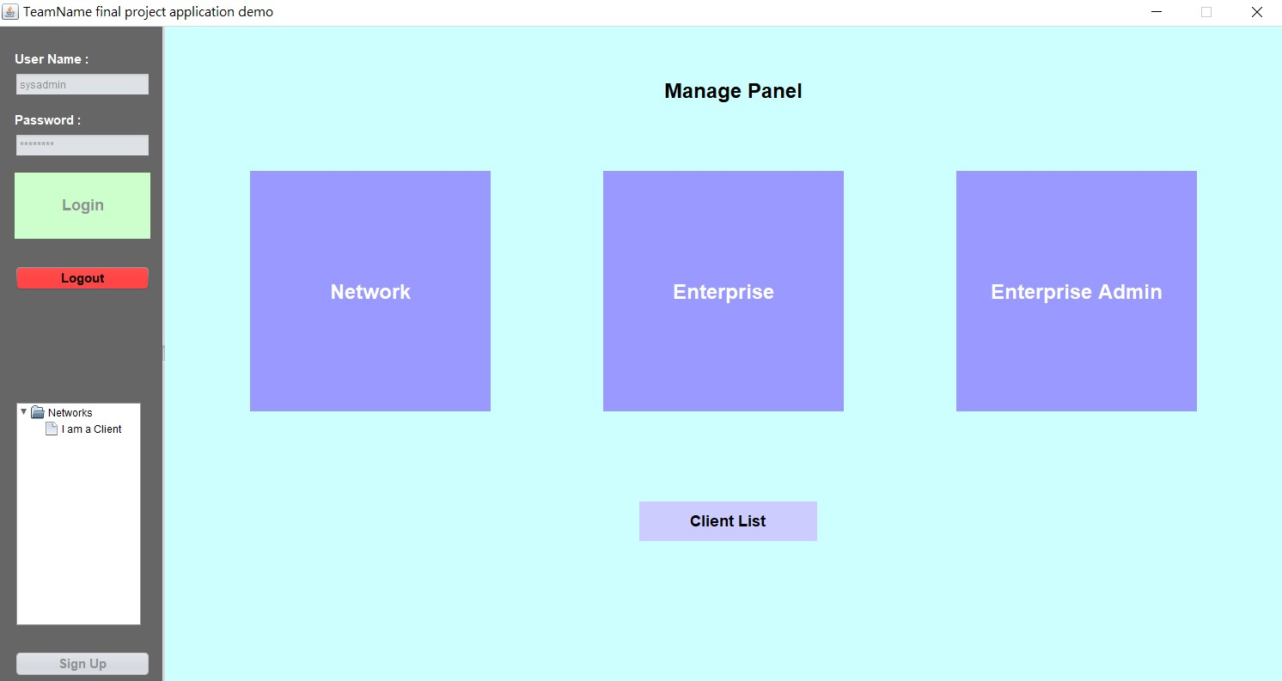
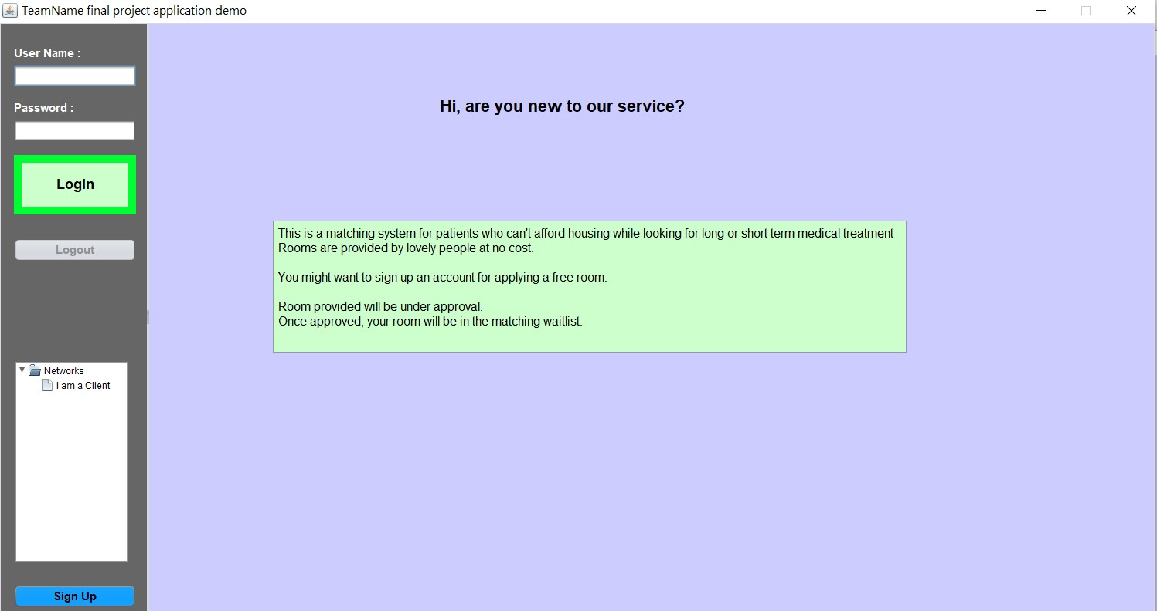
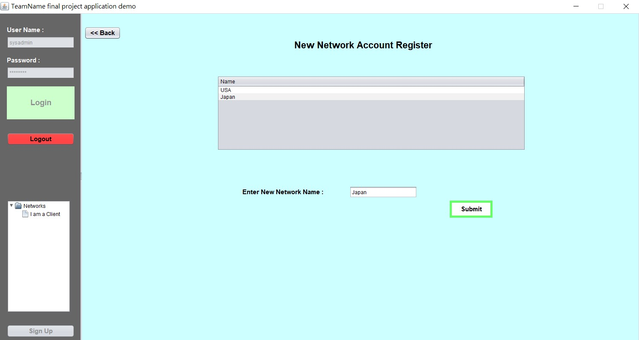
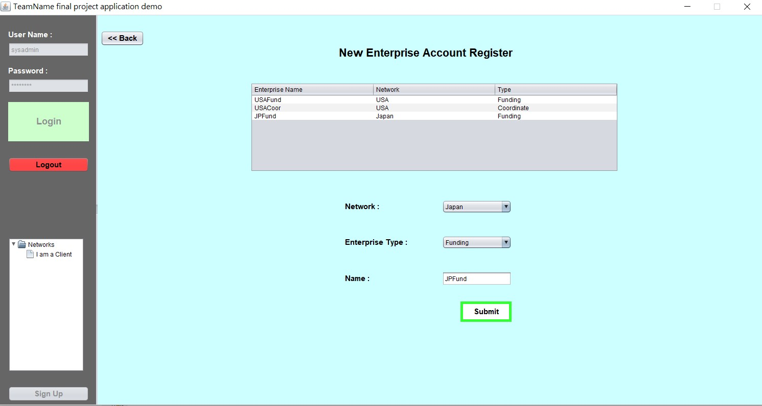
Intro to Our Application
Key screenshots & work flows/ work requests:

Slide 9
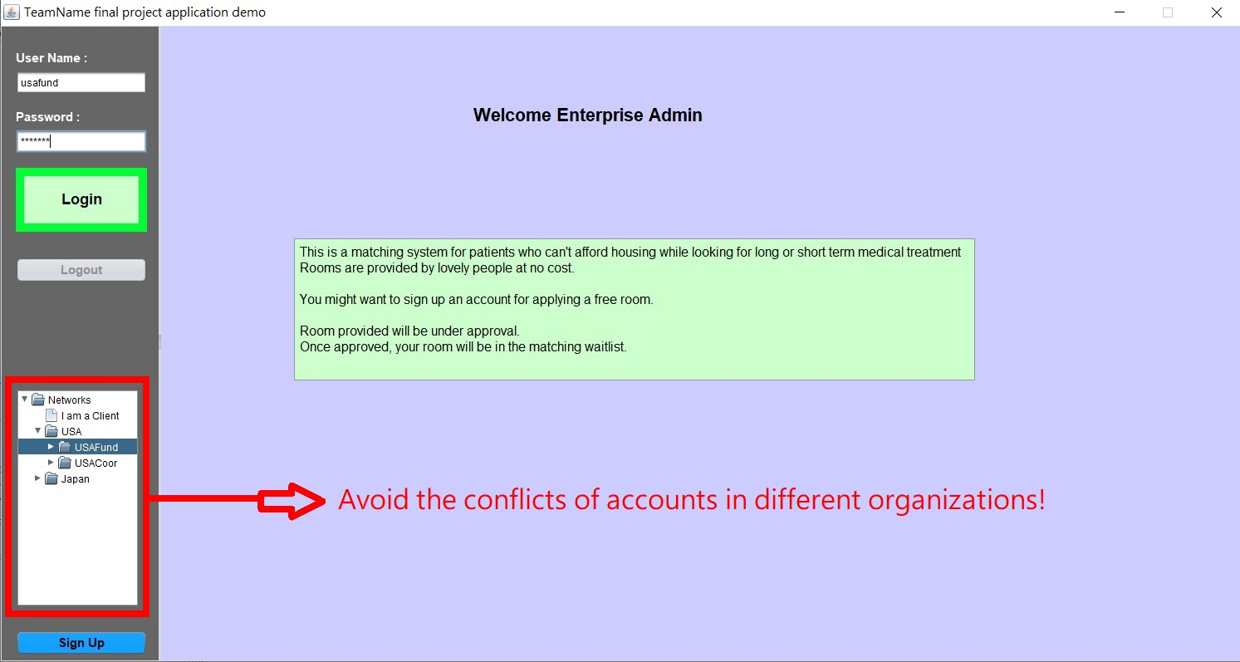
Notes:
Red TREE
Choose different roles

Slide 10
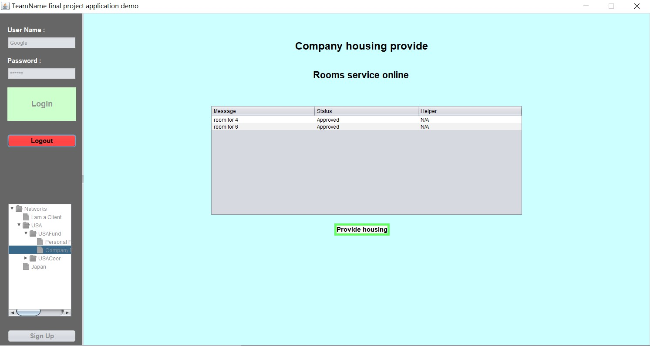
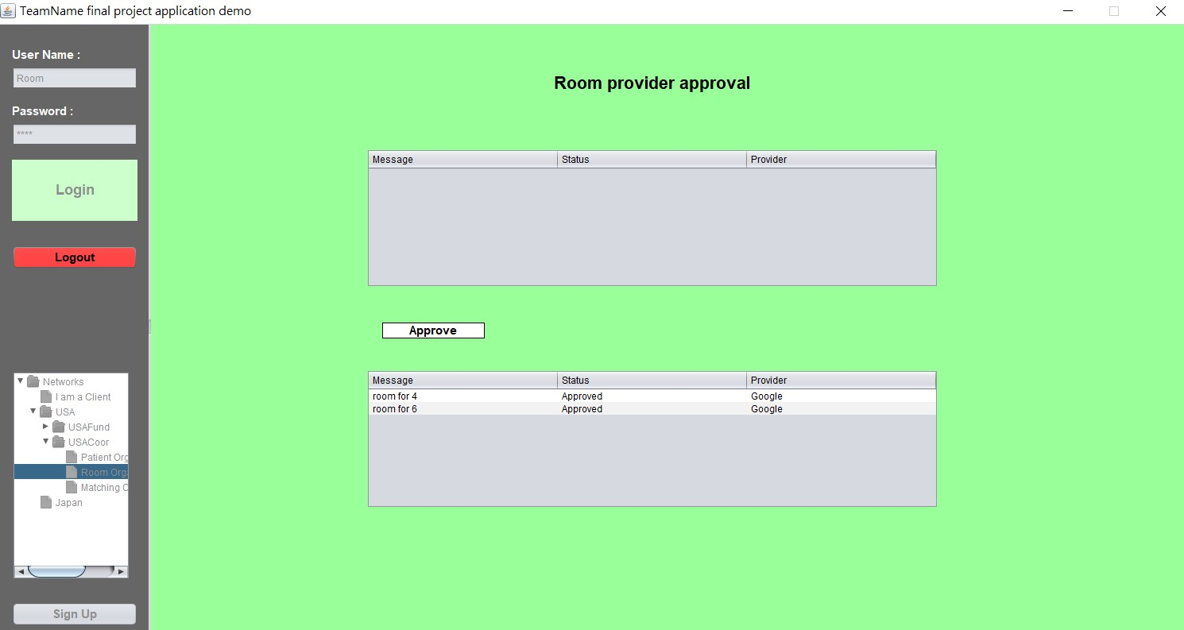
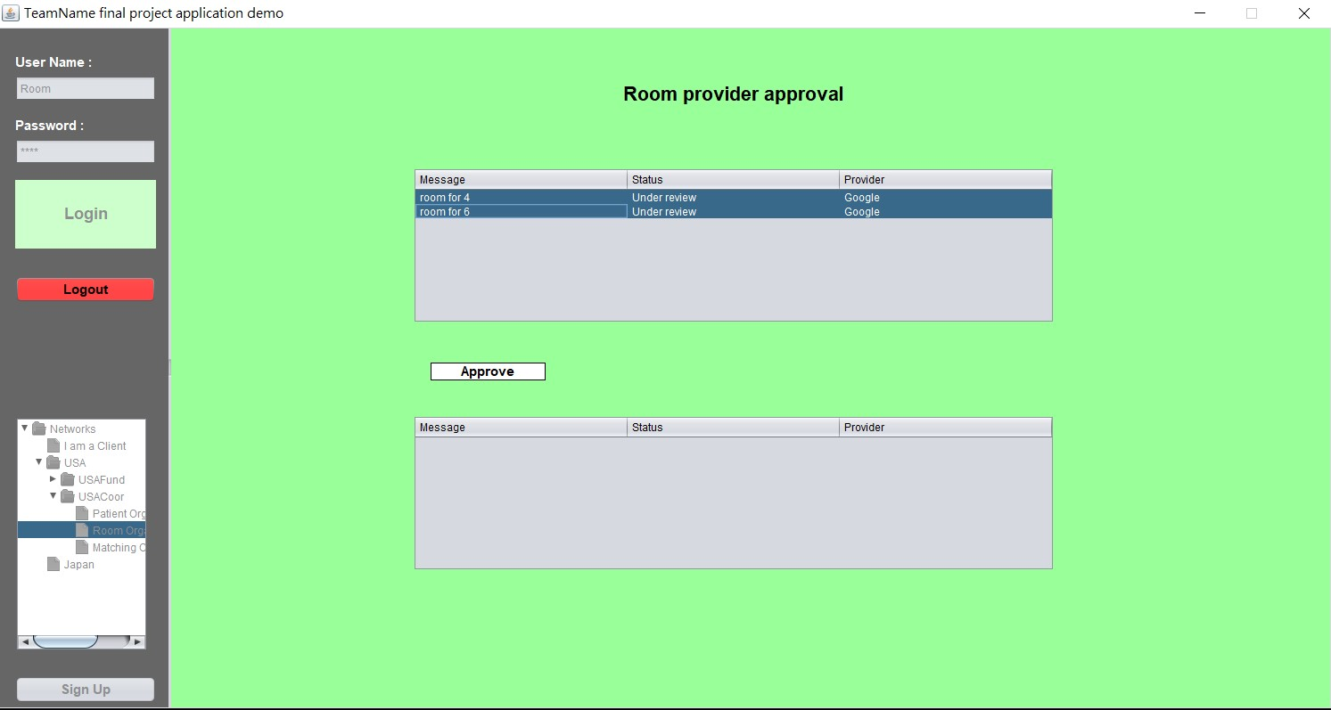
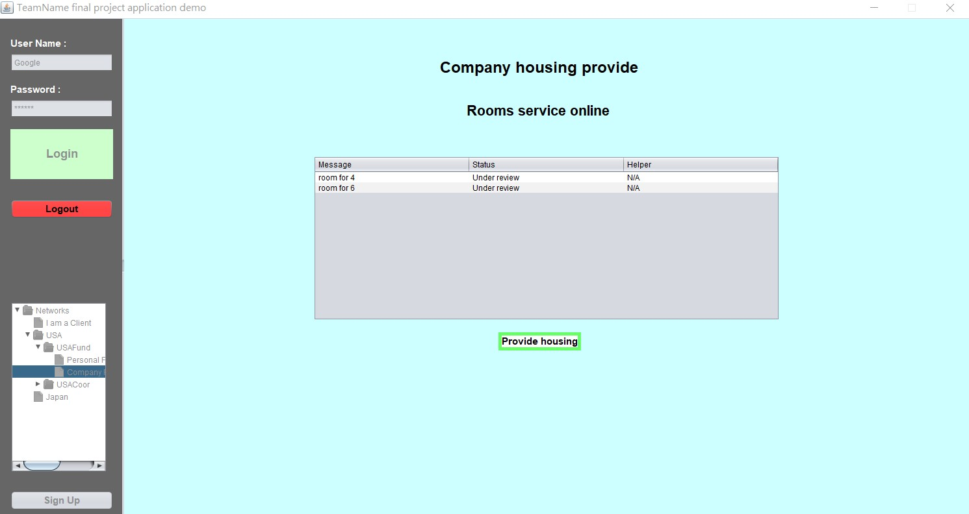
Work Request (Room Offer)

Slide 11

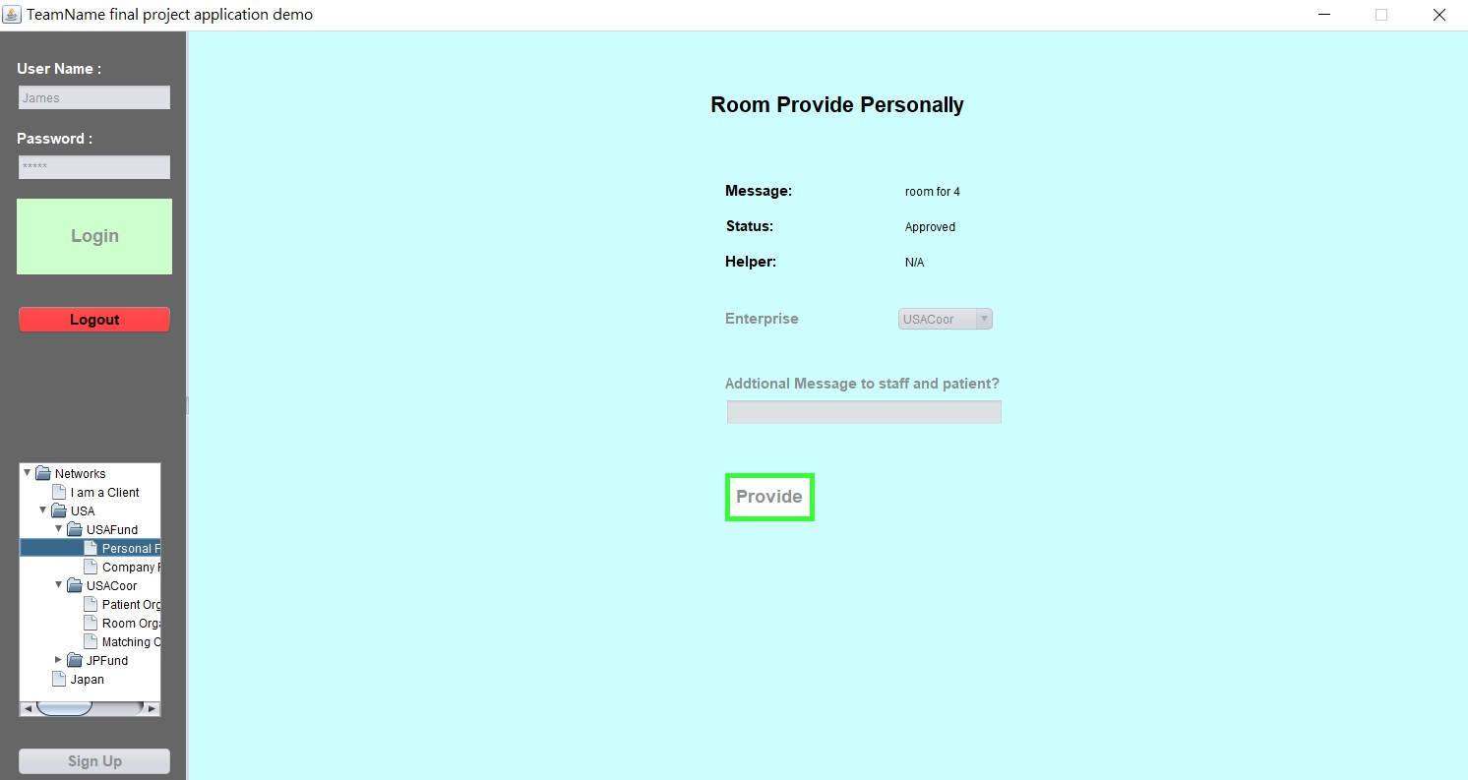
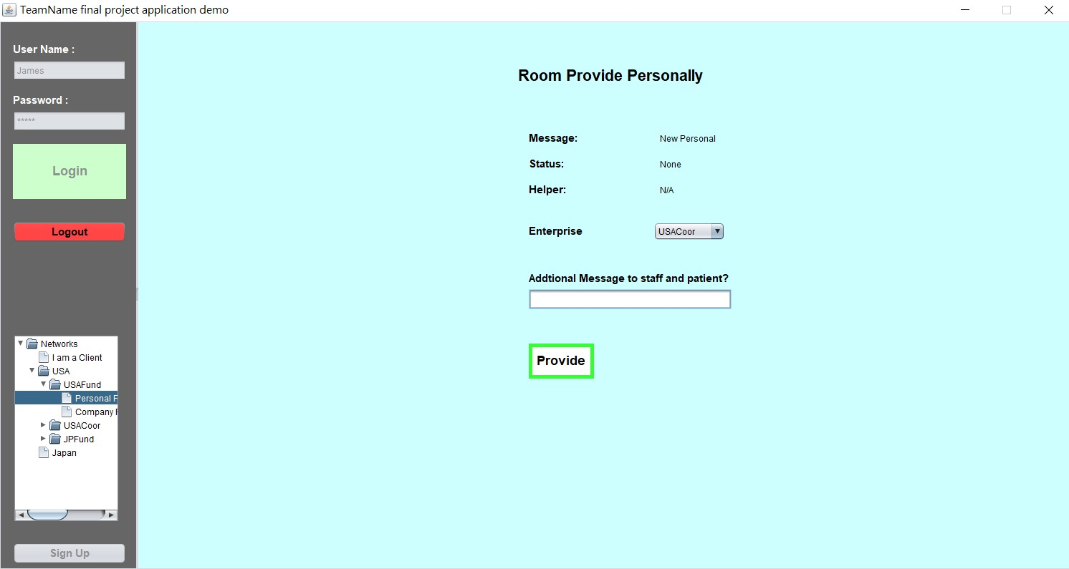
Personal Room Offer

Slide 12

Work flow of room:
Company/ Person offers room. (Status: Under review)
Room organization can approve the rooms offered.
Company/ Person offered room status becomes approved.

Slide 13
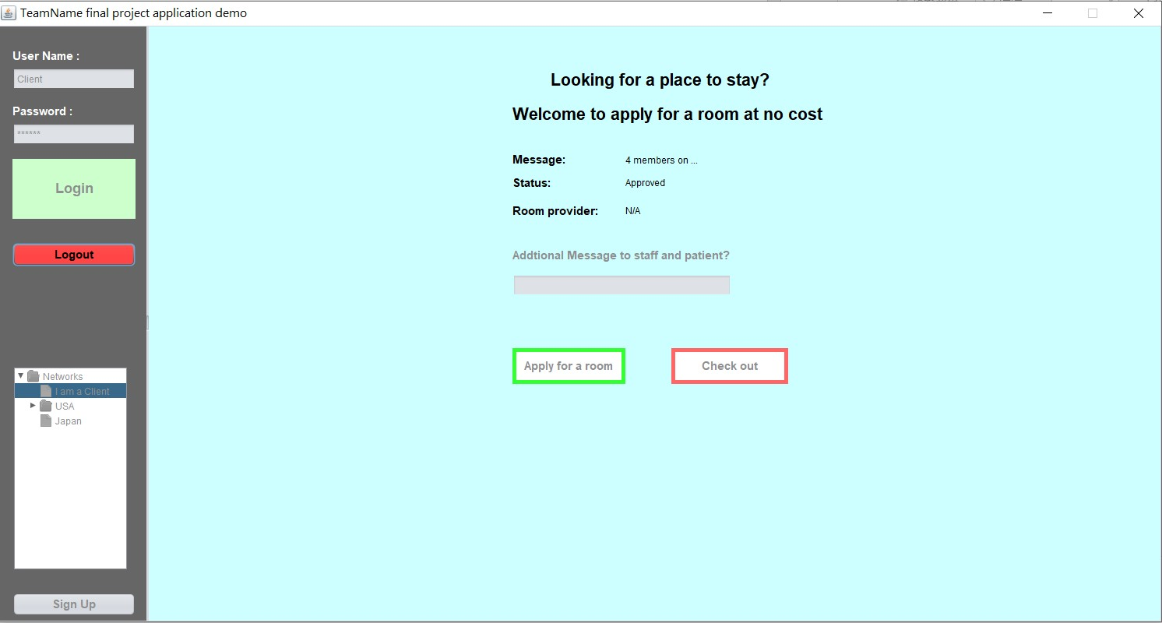
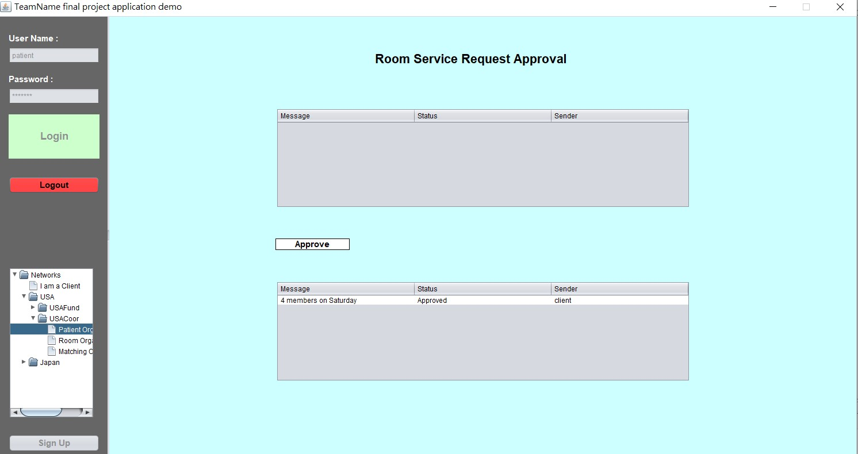
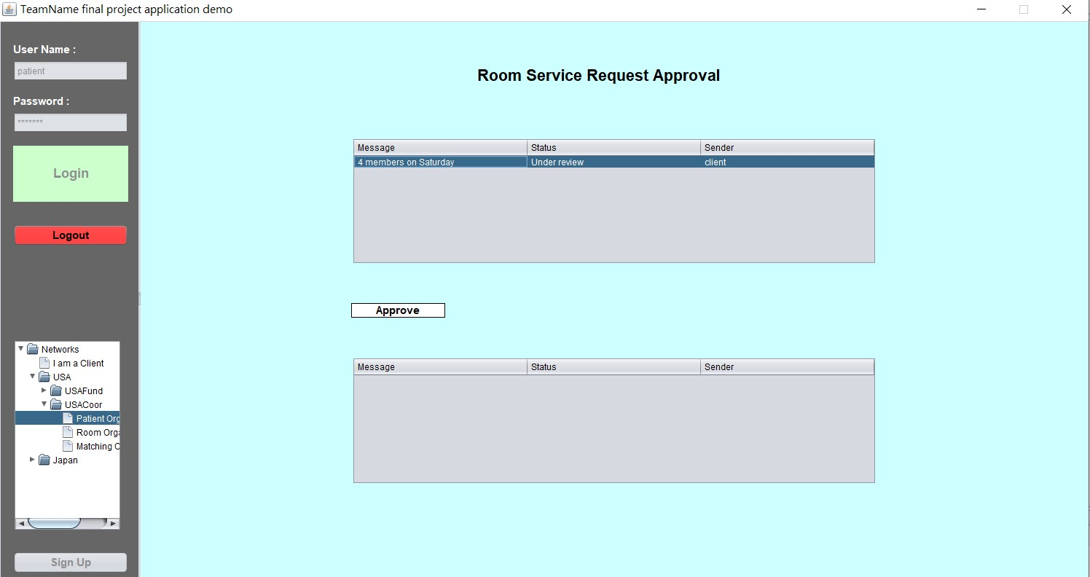
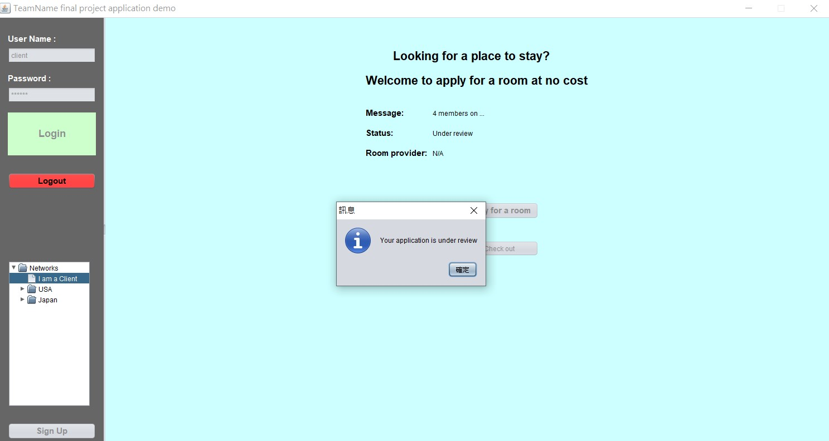
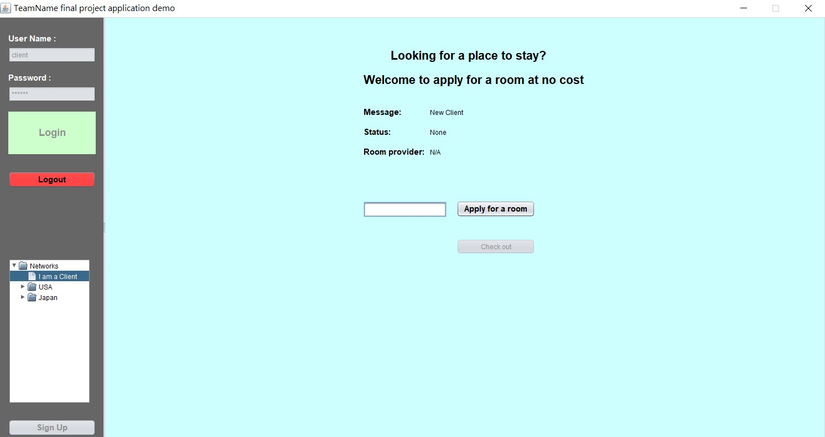
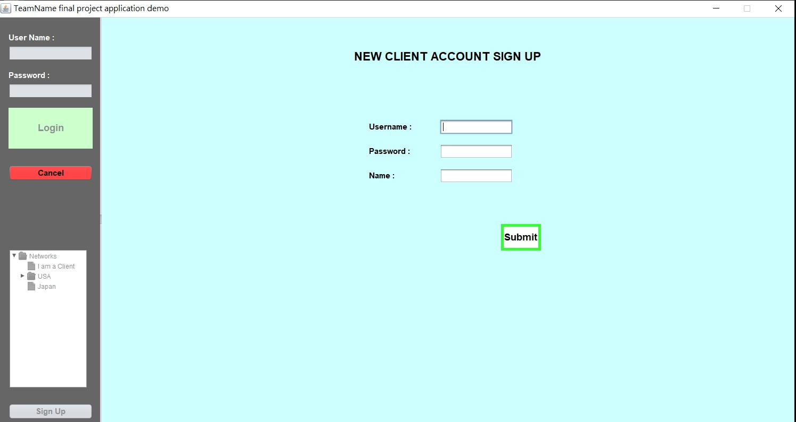
Work Requests (client book a room)
Notes:
7. 4members on saturday

Slide 14
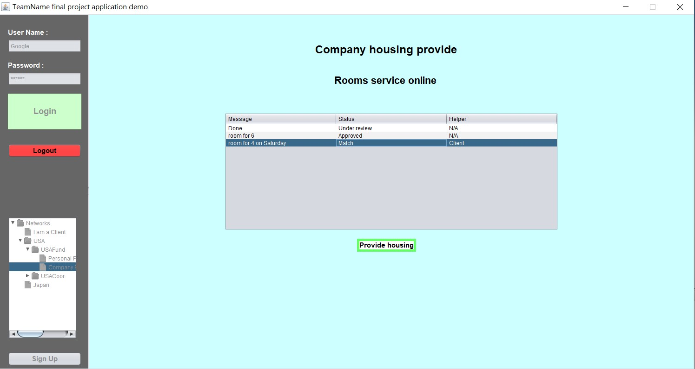

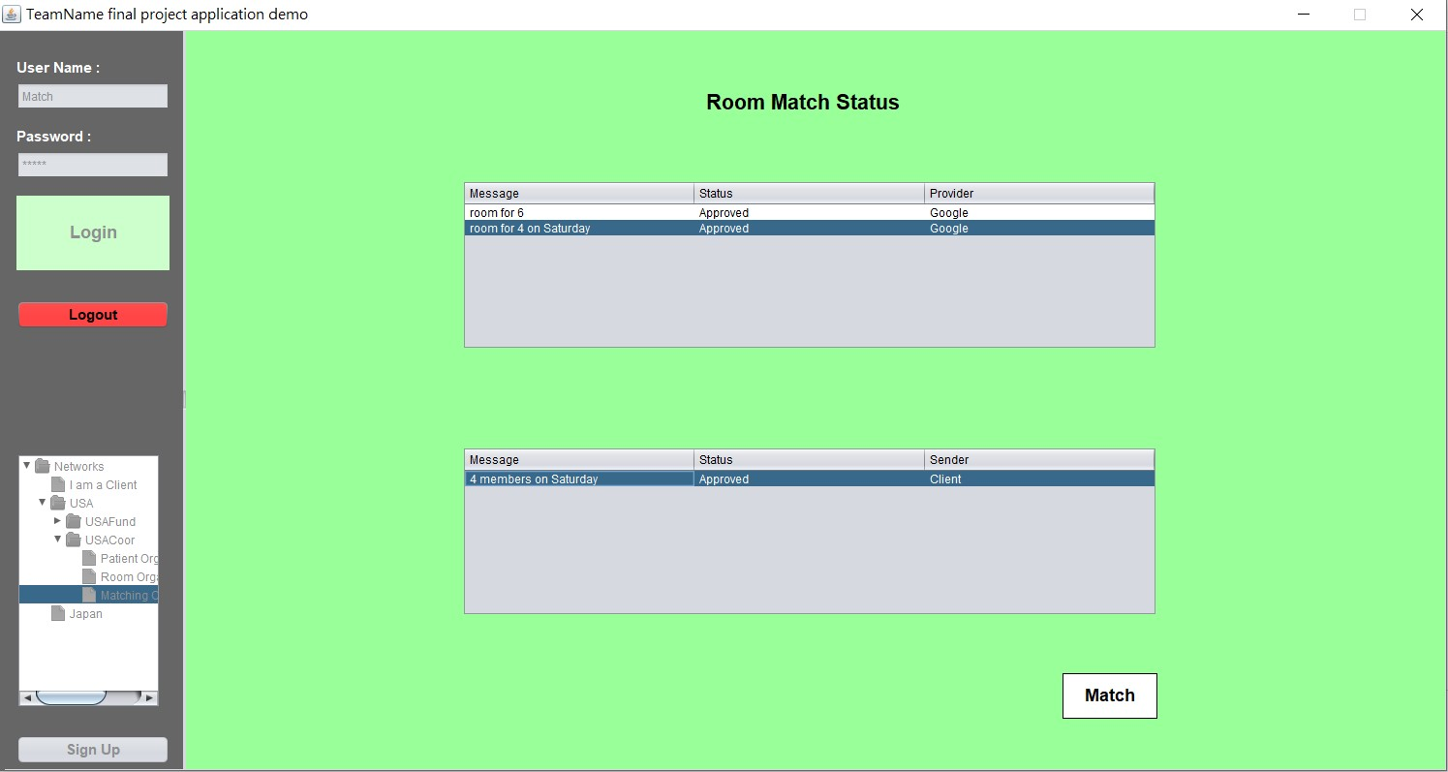
Matching Organization:

Slide 15
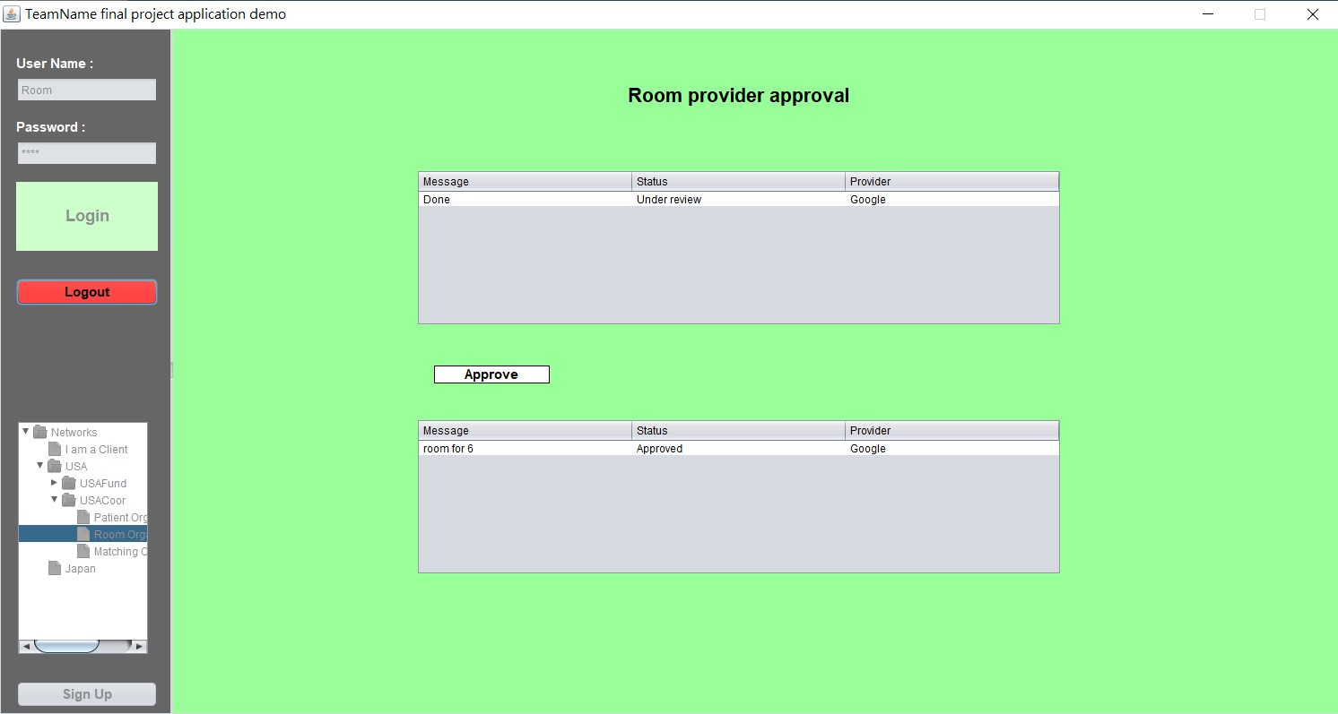

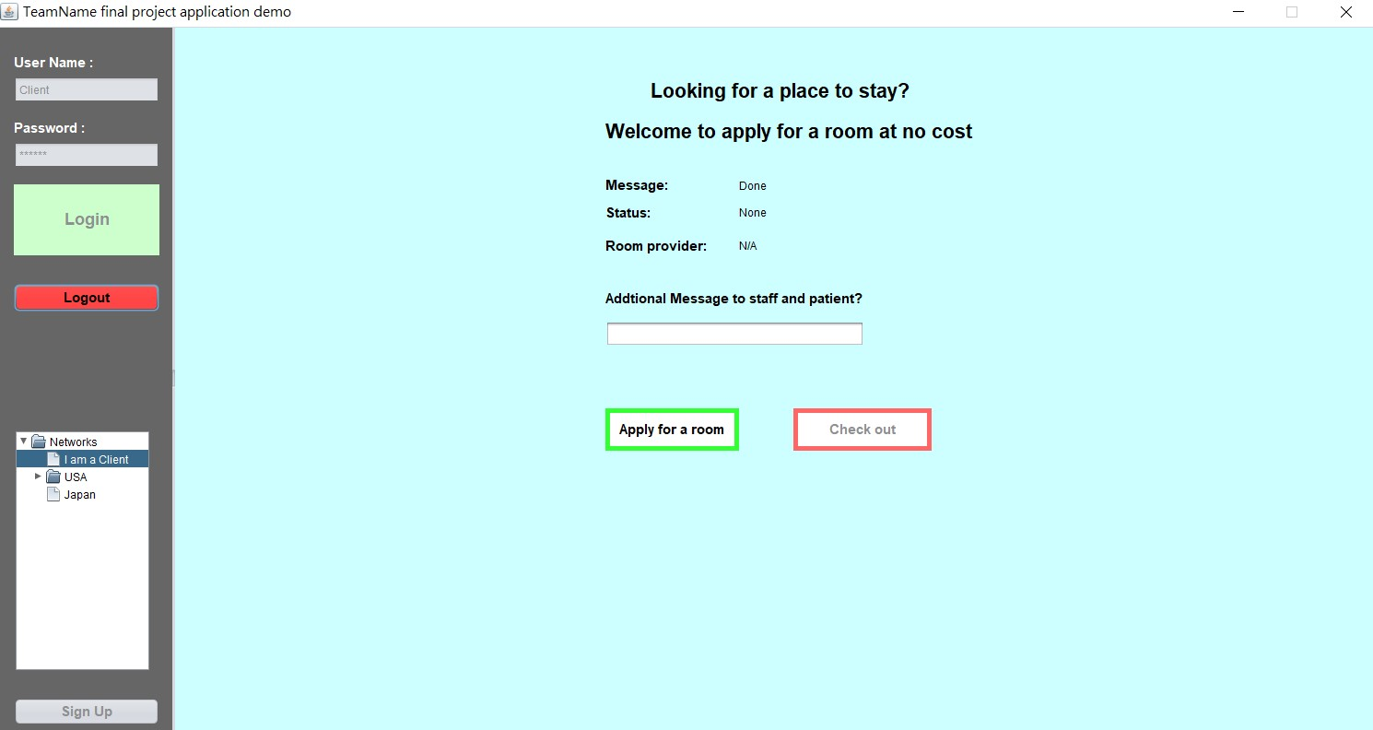
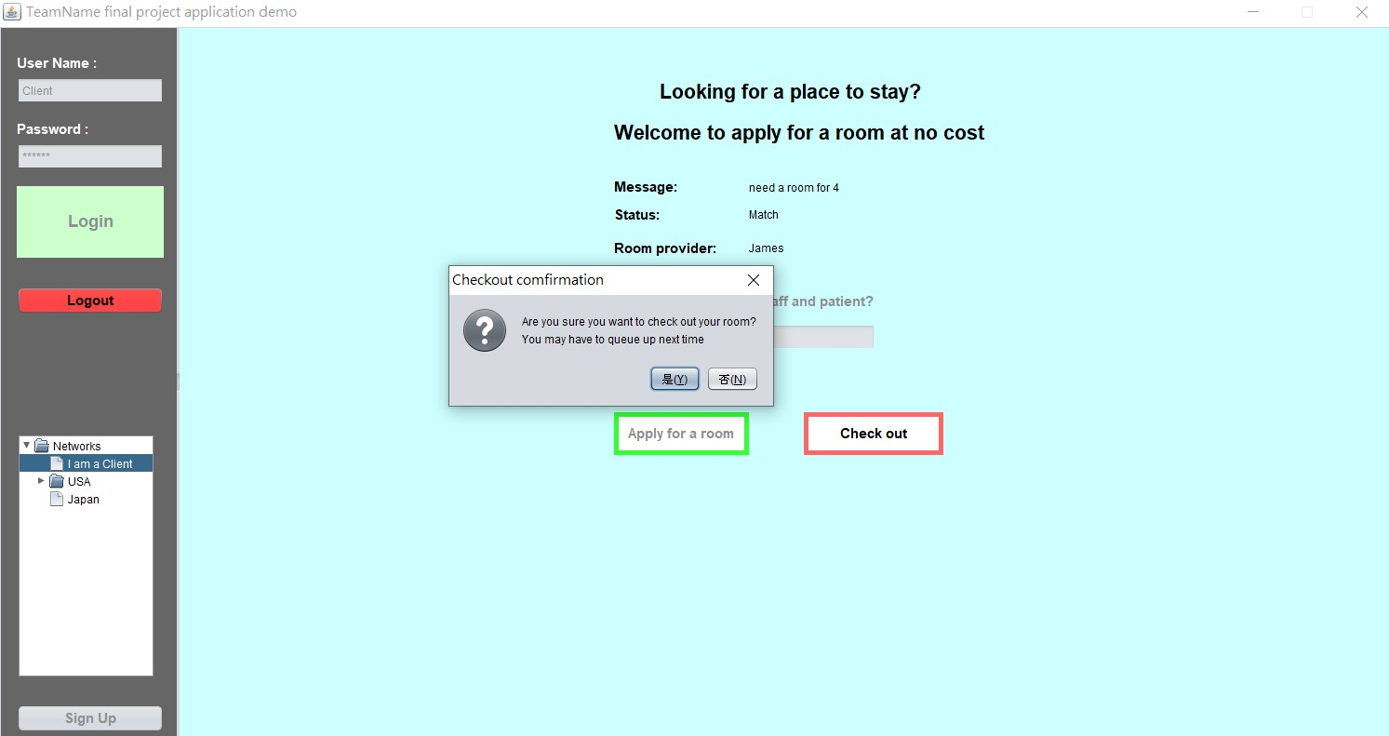
When a client check out:
Notes:
Room provide status

Slide 16
Work flow of applying a room:
Client should set up an account first, then apply for a room. (Status : under review)
Patient organization can approve the application of a client.
Matching organization can match the room and the clients.
When successfully matched, the status becomes match!

Slide 17
Global Level
Global companies like Google, Facebook, Apple, or even local company can be the funding enterprises. Kind people in different countries can also provide their own rooms in their countries.
With the help of local coordinate enterprises, this system can be spread around the world.
Notes:
And why would a global company do it for free?
It can improve the reputation of the company.
They can give back to the society.
It will definitely bring a great commercial effect. Maybe the money they save on advertising is less than the money they help the charity.

Slide 18
Thanks for your time!

